Slide 1
ICS 252
Introduction to Computer Design

Slide 2
Administrative Matters
Time:Tue/Thurs 12:30-1:50 p.m.
Instructor: Prof. Eli Bozorgzadeh
Office Hours:
  By email: eli@ics.uci.edu
  By appointment (email to schedule)
  Stop by my office and if I am free, you are more than welcome…
My office: 3092 Bren Hall
Web page:
  http://www.ics.uci.edu/~eli/courses/ics-252/cs-252-fall08.html
ICS 252
Introduction to Computer Design

Slide 3
Administrative Matters
Textbook:
  G. De Micheli, Synthesis and Optimization of Digital Circuits, McGraw-Hill 1994.
Grades:
  40% project
  25% midterm – closed book
  35% Final -closed book
ICS 252
Introduction to Computer Design

Slide 4
Administrative Matters
Other Textbook References:
  S.H. Gerez, Algorithms for VLSI Design Automation, John Wiley & Sons, 2001.
  N. Sherwani, Algorithms for VLSI Physical Design Automation, KAP, 1999.
  M. Sarrafzadeh, C.K. Wong, An Introduction to VLSI Physical Design, McGrawHill, 1996.
Lectures references: [The notes may be modified by Eli Bozorgzadeh]
  Notes by KiaBazargan from Univ. of Minnesota [©Bazargan]
    http://www.ece.umn.edu/users/kia/Courses/EE5301
  Notes by Kurt Keutzerfrom UC-Berkeley [©Keutzer]
    http://www-cad.eecs.berkeley.edu/~niraj/ee244/index.htm
  Notes by Rajesh Gupta, UC-San Diego [©Gupta]
    http://www.ics.uci.edu/~rgupta/ics280.html
  Notes for the textbook by De Micheli[©GDM]
ICS 252
Introduction to Computer Design

Slide 5
What you learn in this class
Main theme of this class:
  Development of CAD tools from high levels of abstractions down to physical design and layout
Background
  Graph algorithms and data structure, optimization and logic design (ICS151)
Projects
  will be assigned later
ICS 252
Introduction to Computer Design

Slide 6
Overview of the course
Intro to System and design automation
Overview of graph algorithms
High level synthesis
Logic synthesis
Midterm
Physical Design
Project Presentation
Final exam
ICS 252
Introduction to Computer Design

Slide 7
Microelectronic Embedded Systems
Examples: Navigation systems, medical instruments, cell phone, etc…..
Composed of increasingly integrated and complex circuit design > 10⁷ transistors
Integrated circuits are called VLSI or microelectronic circuits
Integrated circuits exploit semiconductor materials
ICS 252
Introduction to Computer Design

Slide 8
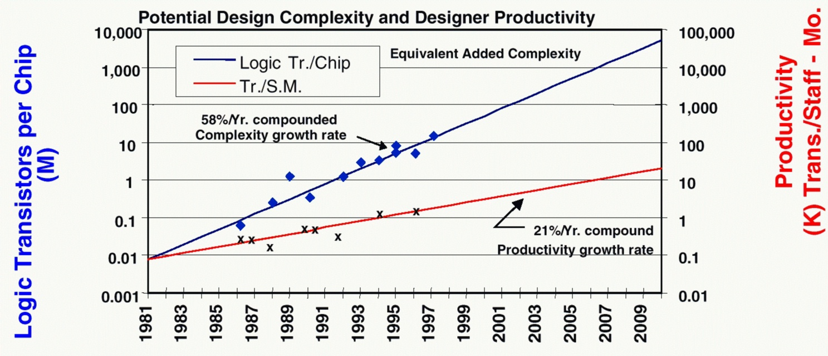
Moore’s Law: capacity doubles every 18 months
ITRS 1999
ICS 252
Introduction to Computer Design

Slide 9
Quadruple Whammy [keutzerEE244]
Increasing complexity of silicon technology
  Signal integrity, cross-coupled capacitance, inductance
Increasing complexity of system design
  Exponential growth (Moore’s law)
Heterogeneity in systems
  Embedded memories, programmable hardware, processor, ASICs, etc…
Shorter time to market
ICS 252
Introduction to Computer Design

Slide 10
Quadruple Whammy [©keutzer, ©Bazargan]
Complexity
Time-to-market
Heterogeneity
DSM Effects
Design of Microelectronic systems
are highly complex and
constrained
ICS 252
Introduction to Computer Design

Slide 11
System Design
System Specification
Design Technology
Algorithms
SW tool
HW tool
Methodology
Design Tools
Physical Implementation
Computer-Aided design (CAD) plays a major role in
  Reduction of design time
  Design optimization
  Large scale design management
ICS 252
Introduction to Computer Design

Slide 12
Silicon Technology and Design Complexity
Design Challenges
Algorithms and
Tools
Methodology and
Flows
Technology characteristics
ICS 252
Introduction to Computer Design

Slide 13
Evolution of EDA Industry [©bazargan,©keutzer]
Results
(design productivity)
What’s next?
Synthesis – Cadence, Synopsys
Schematic entry – Daisy, Mentor, Valid
Transistor entry – Calma, Computervision, Magic
Effort
(EDA tool effort)
McKinsey S-Curve
ICS 252
Introduction to Computer Design

Slide 14
Microelectronic design styles
General-purpose processors:
  High-volume sales.
  High performance.
Application-Specific Integrated Circuits (ASICs):
  Varying volumes and performances.
Prototypes.
Special applications (e.g. space).
ICS 252
Introduction to Computer Design

Slide 15
Microelectronic design styles (cont’d)
Custom and semi-custom designs
semicustom
Cell-based
Array-based
Standard cells
Hierarchical cells
Macro cells
Memory
PLA
Gate matrix, …
Pre-diffused
Gate arrays
Sea of gates
Compacted arrays
Pre-wired
Anti-fuse based
Memory-based
ICS 252
Introduction to Computer Design

Slide 16
Standard Cells (ASIC)
D
C
C
Cell library:
  Cells are designed once.
  Cells are highly optimized.
Layout style:
  Cells are placed in rows.
  Channels are used for wiring.
  Over the cell routing.
Compatible with macro-cells (e.g. RAMs).
B
A
C
C
D
C
D
B
C
C
C
B
ICS 252
Introduction to Computer Design

Slide 17
Macro Cells
Module generators:
  Synthesized layout.
  Variable area and aspect-ratio.
Examples:
  RAMs, ROMs, PLAs, general logic blocks.
Features:
  Layout can be highly optimized.
  Structured-custom design.
ICS 252
Introduction to Computer Design

Slide 18
Array-based Design
Pre-diffused arrays:
  Personalization by metallization/contacts.
  Mask-Programmable Gate-Arrays.
Pre-wired arrays:
  Personalization on the end.
  Field-Programmable Gate-Arrays.
ICS 252
Introduction to Computer Design

Slide 19
FPGAs [©GDM]
Array of cells:
  Each cell performs a
  logic function.
Personalization:
  Soft: memory cell (e.g. Xilinx).
  Hard: Anti-fuse (e.g. Actel).
Immediate turn-around
(for low volumes).
Inferior performances and density.
Good for prototyping and re-customization.
ICS 252
Introduction to Computer Design

Slide 20
Compare choices
Microprocessors
Domain-specific processors
  DSP
  Network processors
  Microcontrollers
Reconfigurable SoC
FPGA
Gatearray
ASIC
Low
Power
Speed
Volume
High
ICS 252
Introduction to Computer Design

Slide 21
Microelectronic circuit optimization
Design
Testing
Modeling
Tester
100000
110011
111000
Synthesis and
optimization
wafer
validation
Packaging
Fabrication
Mask fabrication
slicing
packaging
Wafer fabrication
validation
[©GDM]
ICS 252
Introduction to Computer Design

Slide 22
Microelectronic circuit design
Conceptualization and modeling:
  Hardware Description Languages (HDLs)
Synthesis and optimization:
  Model refinement
Validiation
  Check for correctness
[©GDM]
ICS 252
Introduction to Computer Design

Slide 23
Entities in VLSI Design
Entities
  Area
  Speed (mostly as constraint)
  Power dissipation
  Design time
  Testability
Complexity is too high
  Hierarchy
  Abstraction
ICS 252
Introduction to Computer Design

Slide 24
Modeling Abstractions
Architecture level
  Operations by resources
Logic Level
  Logic functions by resources
Geometric level
  Devices are geometrical objects
Architectural level
…
PC=PC+1;
FETCH(PC);
DECODE(INST);
….
Logic level
Geometrical level
ICS 252
Introduction to Computer Design

Slide 25
Modeling views
Behavioral
  Abstract function
Structural
  Interconnection of parts
Physical
  Physical objects with size and positions
ICS 252
Introduction to Computer Design

Slide 26
Gajski Y-Chart and Design Methodology
Behavioral Domain
Structural Domain
Systems
Algorithms
Processors
Register Transfers
ALU’s, RAM, etc.
Logic
Gates, flip-flops, etc.
Transfer function
Transistors
Transistor level
Cell layout
Module Layout
Floorplans
Physical Domain
Physical Partitions
ICS 252
Introduction to Computer Design

Slide 27
Synthesis
Architectural-level synthesis:
  Determine the macroscopic structure:
  Interconnection of major building blocks.
Logic-level synthesis:
  Determine the microscopic structure:
  Interconnection of logic gates.
Geometrical-level synthesis(Physical design)
  Determine positions and connections.
ICS 252
Introduction to Computer Design

Slide 28
Top-down Design Methodology
Behavioral Domain
Structural Domain
Systems
Algorithms
Processors
Register Transfers
ALU’s, RAM, etc.
Logic
Gates, flip-flops, etc.
Transfer function
Transistors
Transistor level
Cell layout
Module Layout
Floorplans
Physical Partitions
Physical Domain
How is Physical-aware Design flow?
ICS 252
Introduction to Computer Design

Slide 29
Course Outline
Review of Graph theory and basic algorithms
Design/hardware description, system representation and modeling
  HDL, finite-states, data flow, sequencing graphs and other extended models
Behavioral modeling and optimization
  architectural synthesis, compilation, and optimization techniques
High level synthesis and optimization
  scheduling, binding, timing constraints, resource constraints
Logic-level synthesis and optimization
  state encoding, two/multi-level logic optimization
Physical design
  floorplanning, partitioning, placement, and routing
ICS 252
Introduction to Computer Design

Slide 30
Summary
Computer-aided design methodology
  Capture design by VHDL models
  Synthesize more detailed abstractions
  Optimize circuit parameters
Next
  Review of graph algorithm
ICS 252
Introduction to Computer Design

